Slide 1

7Zip
Docker
SQL Server Management Studio
Notes:
https://7-zip.org/download.html
https://desktop.docker.com/win/main/amd64/Docker Desktop Installer.exe?utm_source=docker&utm_medium=webreferral&utm_campaign=docs-driven-download-win-amd64
https://aka.ms/ssmsfullsetup

Slide 2

Data Files
(7 parts)
1/7
2/7
3/7
4/7
5/7
6/7
7/7
Dockerfile
DOWNLOADS
Notes:
https://huggingface.co/datasets/DenyTranDFW/SEC-Financial-Statements-And-Notes-Dataset/resolve/main/dockerfile_requirements_mdf_ldf/data.part01.rar?download=true
https://huggingface.co/datasets/DenyTranDFW/SEC-Financial-Statements-And-Notes-Dataset/resolve/main/dockerfile_requirements_mdf_ldf/data.part02.rar?download=true
https://huggingface.co/datasets/DenyTranDFW/SEC-Financial-Statements-And-Notes-Dataset/resolve/main/dockerfile_requirements_mdf_ldf/data.part03.rar?download=true
https://huggingface.co/datasets/DenyTranDFW/SEC-Financial-Statements-And-Notes-Dataset/resolve/main/dockerfile_requirements_mdf_ldf/data.part04.rar?download=true
https://huggingface.co/datasets/DenyTranDFW/SEC-Financial-Statements-And-Notes-Dataset/resolve/main/dockerfile_requirements_mdf_ldf/data.part05.rar?download=true
https://huggingface.co/datasets/DenyTranDFW/SEC-Financial-Statements-And-Notes-Dataset/resolve/main/dockerfile_requirements_mdf_ldf/data.part06.rar?download=true
https://huggingface.co/datasets/DenyTranDFW/SEC-Financial-Statements-And-Notes-Dataset/resolve/main/dockerfile_requirements_mdf_ldf/data.part07.rar?download=true
https://huggingface.co/datasets/DenyTranDFW/SEC-Financial-Statements-And-Notes-Dataset/resolve/main/dockerfile_requirements_mdf_ldf/Dockerfile?download=true

Slide 3
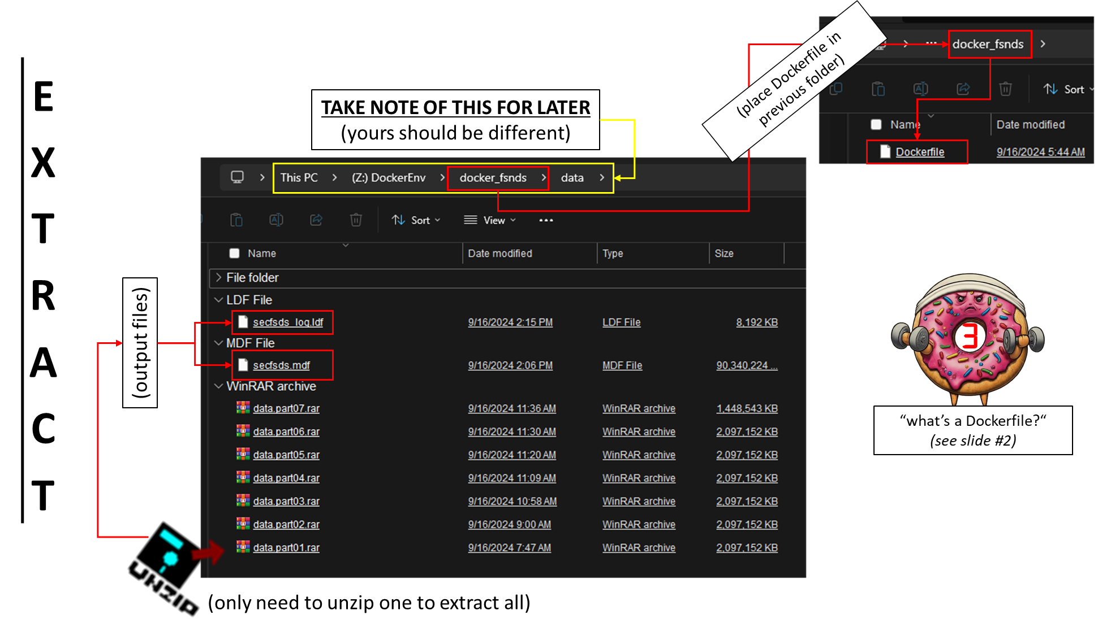
Notes:
NO NOTES :[

Slide 4
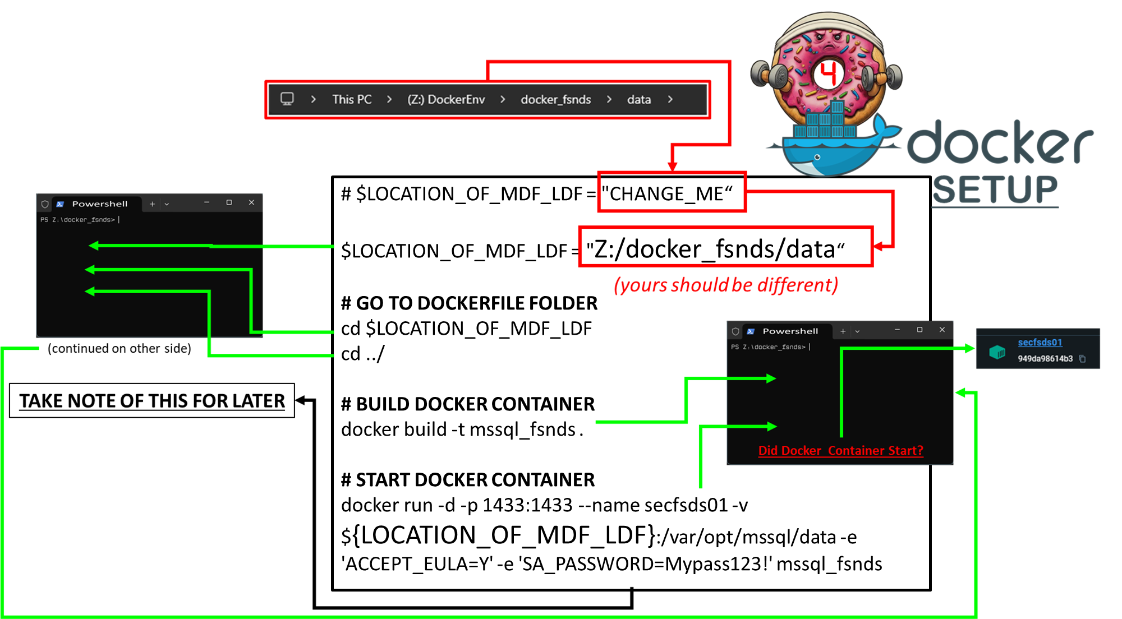
USERNAME
SA
PASSWORD
Mypass123!
Notes:
# UPDATE CHANGE_ME AND PASTE INTO YOUR POWERSHELL TERMINAL
$LOCATION_OF_MDF_LDF = "CHANGE_ME“
# GO TO DOCKERFILE FOLDER
cd $LOCATION_OF_MDF_LDF
cd ../
# BUILD DOCKER CONTAINER
docker build -t mssql_fsnds .
# START DOCKER CONTAINER
docker run -d -p 1433:1433 --name secfsds01 -v ${LOCATION_OF_MDF_LDF}:/var/opt/mssql/data -e 'ACCEPT_EULA=Y' -e 'SA_PASSWORD=Mypass123!' mssql_fsnds

Slide 5
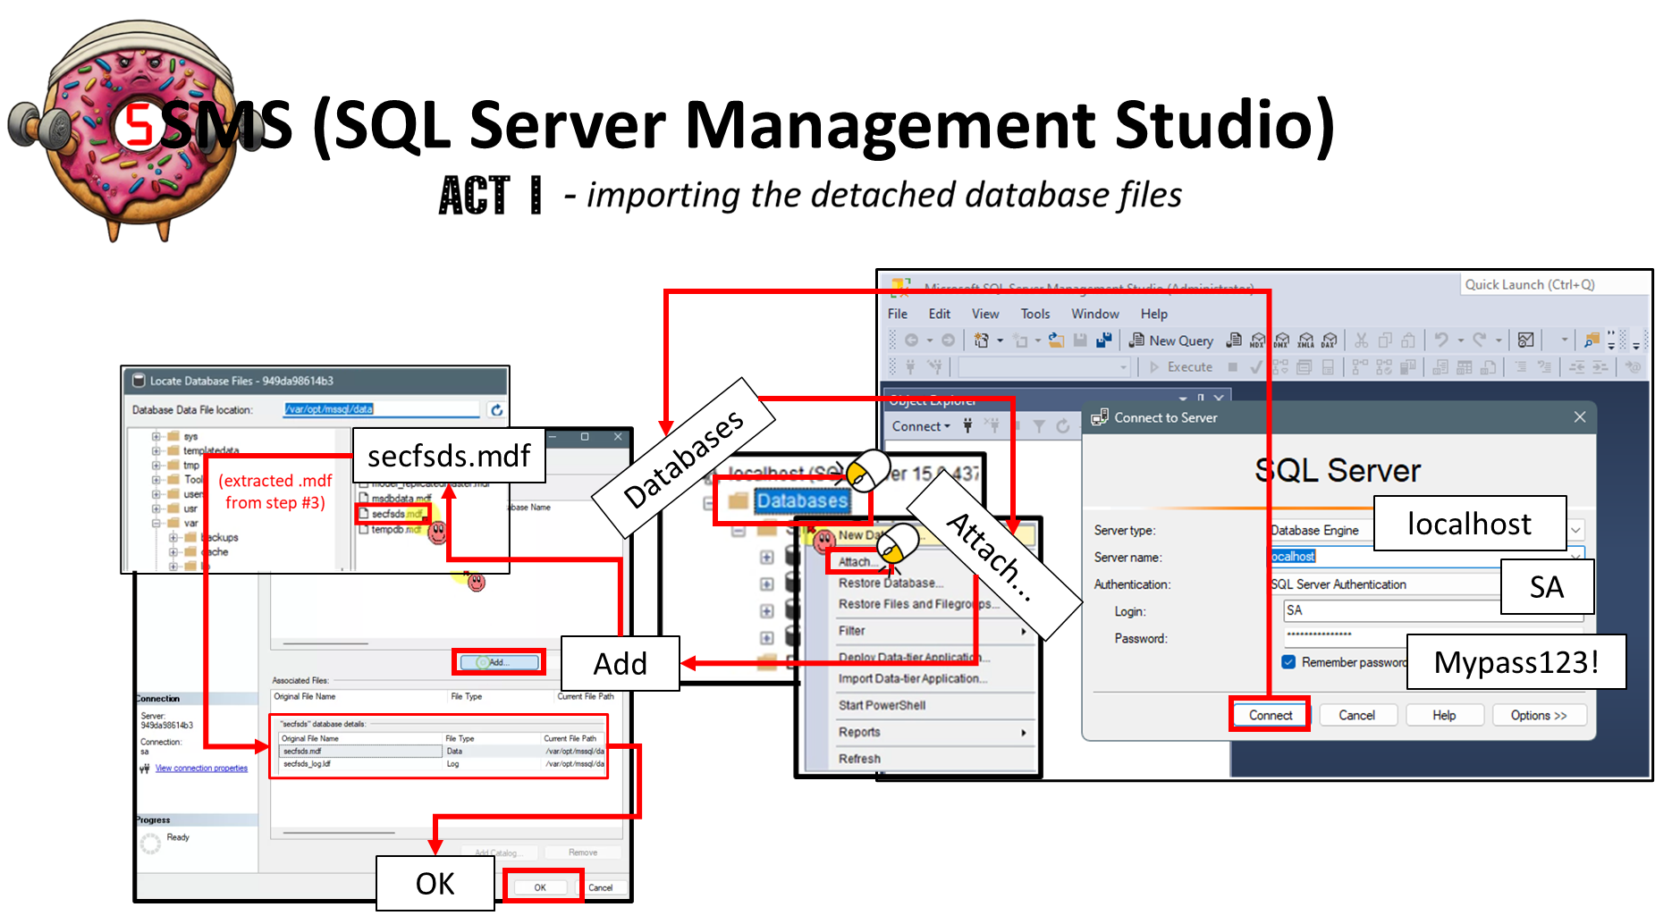
Notes:
USERNAME
SA
PASSWORD
Mypass123!

Slide 6
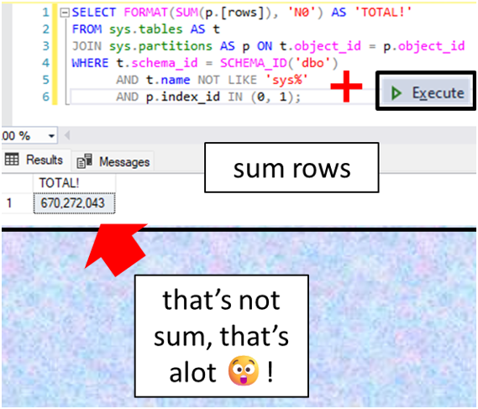
Notes:
SELECT STRING_AGG(t.name, ', ') AS TableNames
FROM sys.tables AS t
WHERE t.schema_id = SCHEMA_ID('dbo')
AND t.name NOT LIKE 'sys%';
SELECT
t.name AS TableName,
SUM(p.[rows]) AS RowCount
FROM
sys.tables AS t
JOIN
sys.partitions AS p ON t.object_id = p.object_id
WHERE
t.schema_id = SCHEMA_ID('dbo')
AND t.name NOT LIKE 'sys%'
AND p.index_id IN (0, 1) -- 0 = Heap, 1 = Clustered
GROUP BY
t.name
ORDER BY
t.name;
SELECT FORMAT(SUM(p.[rows]), 'N0') AS 'TOTAL!'
FROM sys.tables AS t
JOIN sys.partitions AS p ON t.object_id = p.object_id
WHERE t.schema_id = SCHEMA_ID('dbo')
AND t.name NOT LIKE 'sys%'
AND p.index_id IN (0, 1);

Slide 7


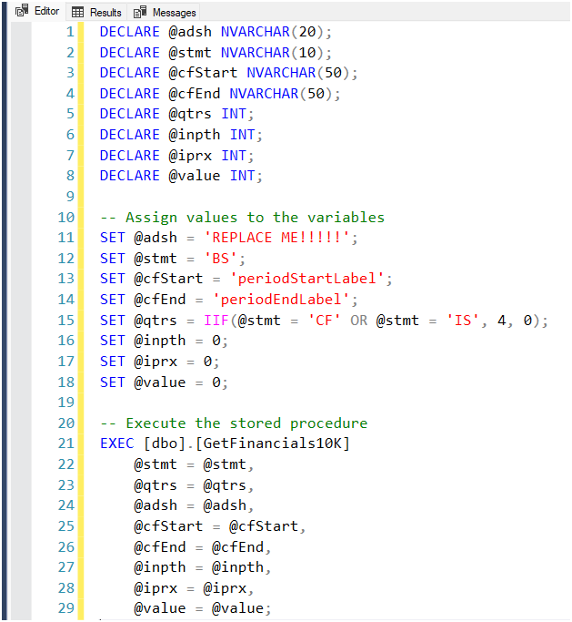


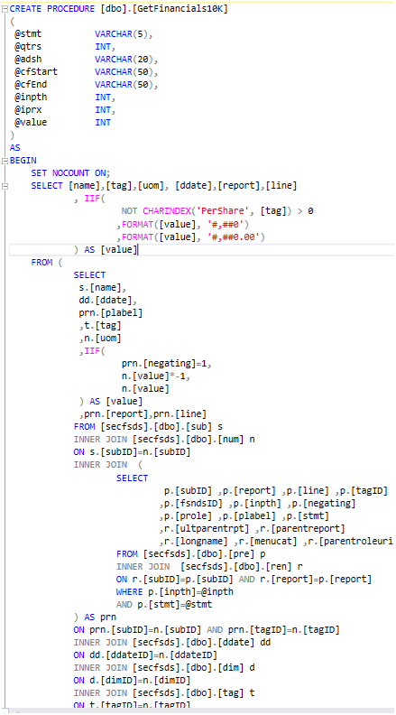
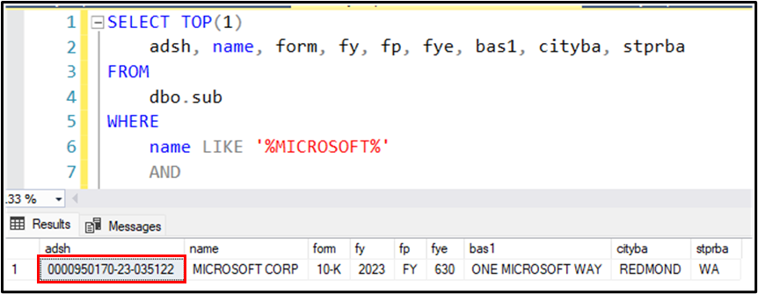

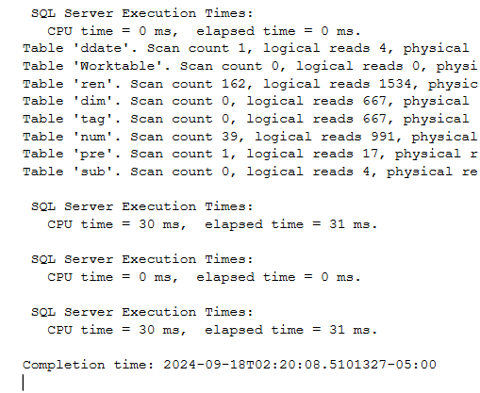

Notes:
FAST OR SLOOOOOW?

Slide 8

Notes:
THE END

